Slide 1
Galaxy Dash by Honeydew
Milestone 1 – Project Pitch
Brought to you by _____

Slide 2
Team Structure – Names and Roles
Director – Noah
Producer – Diana
Art Lead – Octavio
Game Design Lead – Nick
Sound Lead – Tom
Tech Lead – Josh

Slide 3
High Concept
Galaxy Dash is a simple and fun game where the player makes a Laser Knight either jump over killer aliens or dodge low flying UFOs, or ducks under higher flying meteorites as he runs across a flat terrain faster and faster as time goes by. It is perfect for anyone who wants to kill time, since it is engaging and has the competitive factor of trying to beat your high score for how long you go without bumping into any obstacles.

Slide 4
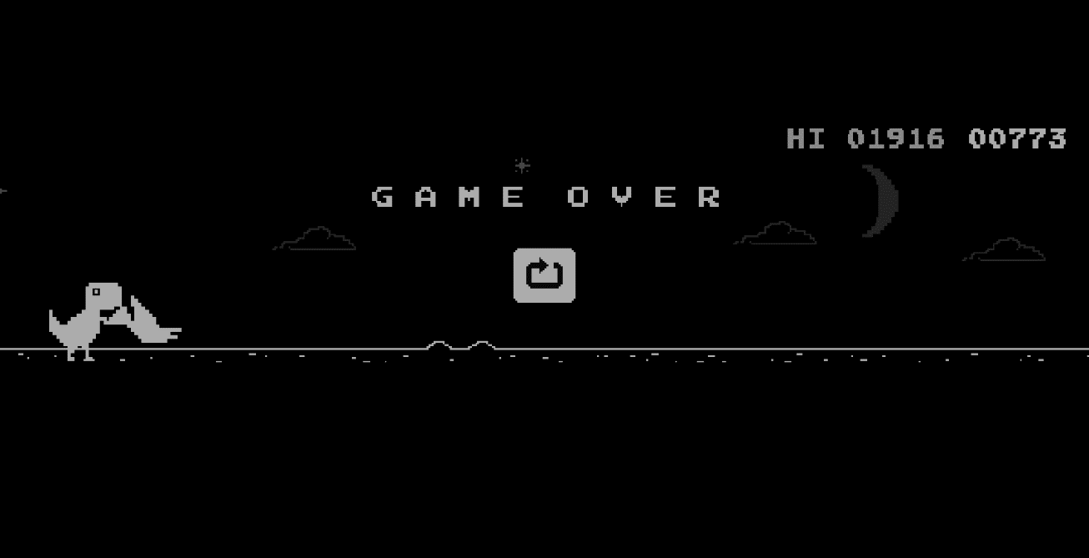
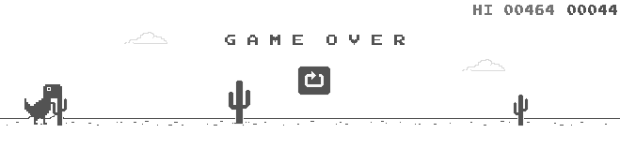
Reference

Slide 5
Design And Features
Keyboard for input
You control a dinosaur
Up and down movement with spacebar and arrow keys
Running across the screen as you either duck under or jump over pterodactyls, and jump over different cacti

Slide 6
Engine And Features

Slide 7
Art
Style:
Pixel art (using piskel)

Slide 8
Art Asset Research

Slide 9
Audio – Music and Sound

Slide 10
Sound Schedule

Slide 11
Tech Schedule

Slide 12
Plus Content
Plus Tech
Plus Art

Slide 13
Budget and Materials

Slide 14
Thank You!
Galaxy Dash by Honeydew

